Slide 1
Indian Food Data Analytics
In Power BI with the help of Python
BY PRIYANKA AND AISHWARYA

Slide 2
Steps :
Data Import
Data cleaning
Data Analysing
Making Dashboard
Answer the Question

Slide 3
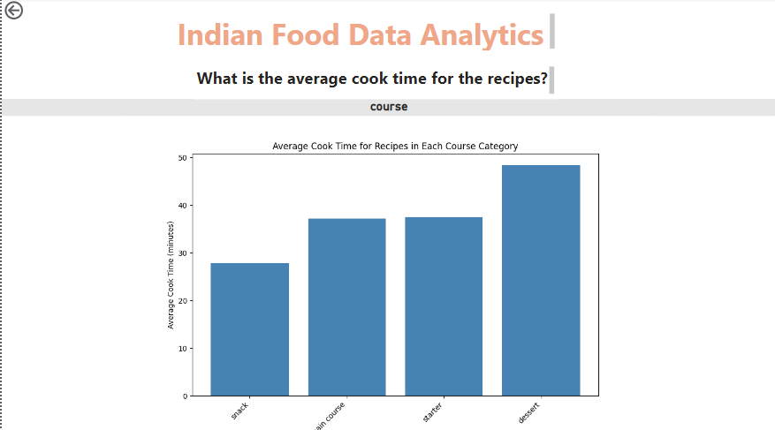

Slide 4
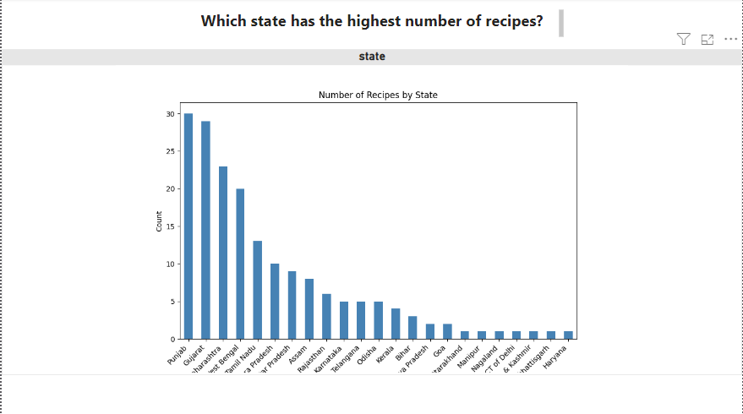

Slide 5
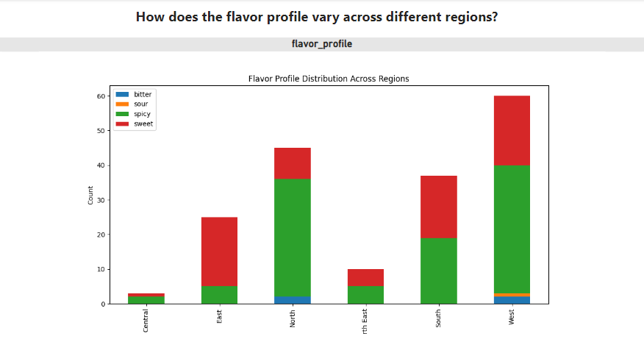

Slide 6
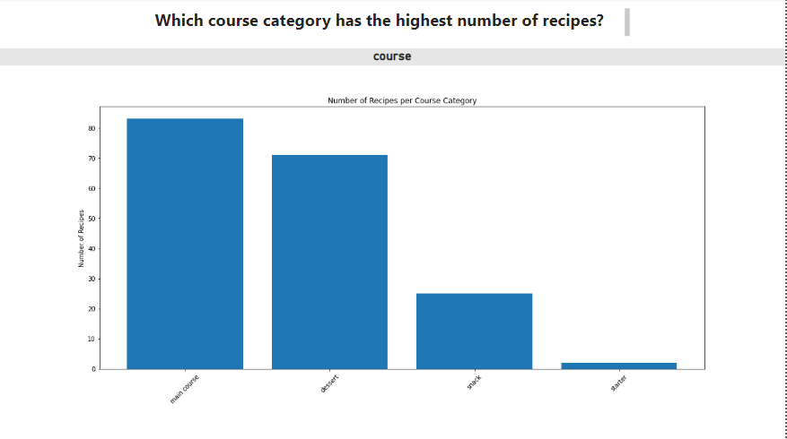

Slide 7
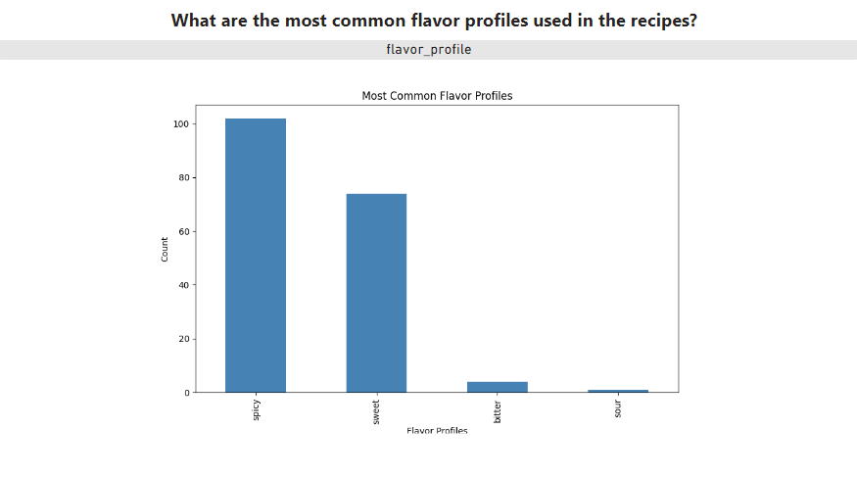

Slide 8
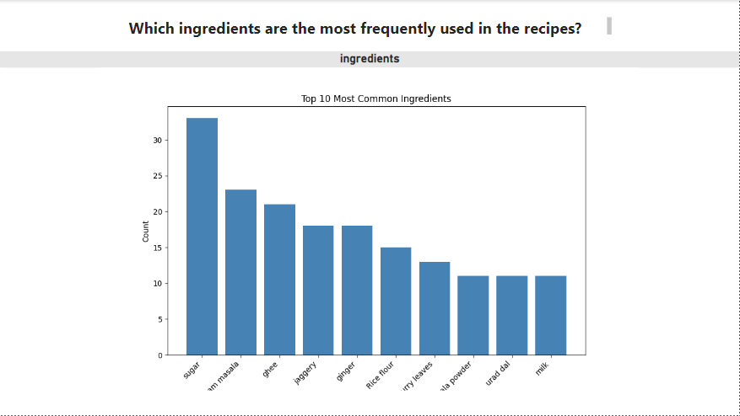

Slide 9
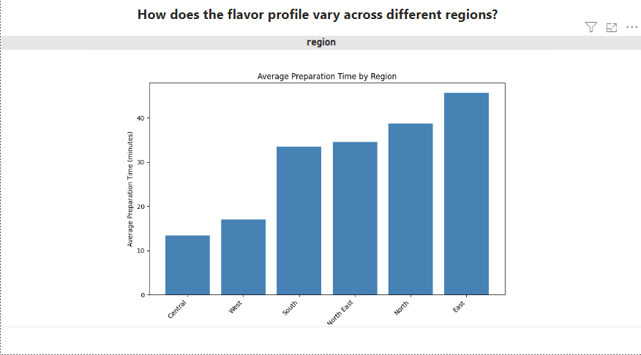

Slide 10
Thank You

